Slide 1
Matthew 7:24-29
Pastor Alvin Tan
Uploaded by Dr. Rick Griffith, Crossroads International Church Singapore cicfamily.com & BibleStudyDownloads.org

Slide 2
Introduction
4 Statements that should strike fear in us :
We can be seconds from disaster.
Disasters don’t just happen. They had warning signs which were ignored.
Patching up cracks will not prevent the disaster.
Lives lost could have been saved.

Slide 4
The Background
Central Theme of Matthew is “God’s Kingdom.”
Context of Matt 5-7 is “So his fame spread…seeing the crowds…” (Matt 4:23-5:1)
Matthew 5-7 is Jesus’ lengthy exposition on :
What is Kingdom Citizenship & Righteousness (5:1-20)?
What is Human Citizenship & Righteousness (6:1-7:12)?
What could Happen if we Mistook the Difference (7:13-29)?

Slide 5
The Big Idea
Jesus is Calling us to re-assess the Structural Integrity of our Salvation, our Faith and our Lives because a Day of Reckoning is coming.

Slide 6
“Remember, there is only one foundation, the one already laid: Jesus Christ. Take particular care in picking out your building materials. Eventually there is going to be an inspection. If you use cheap or inferior materials, you’ll be found out. The inspection will be thorough and rigorous. You won’t get by with a thing. If your work passes inspection, fine; if it doesn’t, your part of the building will be torn out and started over. But you won’t be torn out; you’ll survive—but just barely”
(1 Cor 3:11-15, The Message)

Slide 7
1. We Are All Involved in “Building”
The “Building” Metaphor refers to 1 Cor 3:9-15
Who is the Foundation of Our Salvation? (vv. 10-11).

Slide 8
“According to the grace of God given to me, like a skilled master builder I laid a foundation, and someone else is building upon it. Let each one take care how he builds upon it. For no one can lay a foundation other than that which is laid, which is Jesus Christ.”
(1 Cor 3:10-11)

Slide 9
1. We Are All Involved in “Building”
The “Building” Metaphor refers to …1 Cor 3:9-15
Who is the Foundation of Our Salvation? (v. 11)
What We Do with Our Faith/Lives (vv. 9-10, 12-15)

Slide 10
“For we are God’s fellow workers. You are God’s field, God’s building. According to the grace of God given to me, like a skilled master builder I laid a foundation, and someone else is building upon it.”
(1 Cor 3:9-10)

Slide 11
“Now if anyone builds on the foundation with gold, silver, precious stones, wood, hay, straw - each one’s work will become manifest, for the Day will disclose it, because it will be revealed by fire, and the fire will test what sort of work each one has done. If the work that anyone has built on the foundation survives, he will receive a reward. If anyone’s work is burned up, he will suffer loss, though he himself will be saved, but only as through fire...”
(1 Cor 3:12-15)

Slide 12
1. We Are All Involved in “Building”
The “Building” Metaphor refers to …1 Cor 3:9-15
Who is the Foundation of Our Salvation? (v. 11)
What We Do with Our Faith/Lives (vv. 9-10, 12-15)
What We Do with and In Our Bodies (vv. 16-17; 2 Cor 5:9-10).

Slide 13
“Do you not know that you are God’s temple and that God’s Spirit dwells in you? If anyone destroys God’s temple, God will destroy him. For God’s temple is holy, and you are that temple.”
(1 Cor 3:16-17)
“Or do you not know that your body is a temple of the Holy Spirit within you, whom you have from God? You are not your own.”
(1 Cor 6:19)

Slide 14
“So whether we are at home or away, we make it our aim to please him. For we must all appear before the judgment seat of Christ, so that each one may receive what is due for what he has done in the body, whether good or evil.”
(2 Cor 5:9-10)

Slide 15
1. We Are All Involved in “Building”
The “Building” Metaphor refers to …1 Cor 3:9-15
Who is the Foundation of Our Salvation? (v. 11)
What We Do with Our Faith/Lives (vv. 9-10, 12-15)
What We Do with and In Our Bodies (vv. 16-17; 2 Cor 5:9-10).
What We Do with Our Church (Eph 2:19-22; 4:12).

Slide 16
“So then you are no longer strangers and aliens, but you are fellow citizens with the saints and members of the household of God, built on the foundation of the apostles and prophets, Christ Jesus himself being the cornerstone, in whom the whole structure, being joined together, grows into a holy temple in the Lord. In him you also are being built together into a dwelling place for God by the Spirit.”
(Eph 2:19-22)

Slide 17
“And he gave the apostles, the prophets, the evangelists, the shepherds and teachers, to equip the saints for the work of ministry, for building up the body of Christ.”
(Eph 4:11-12)

Slide 18
1. We Are All Involved in “Building”
The “Building” Metaphor refers to …1 Cor 3:9-15
Who is the Foundation of Our Salvation? (v11).
What We Do with Our Faith/Lives? (vv9-10;12-15).
What We Do with In/Our Bodies? (vv16-17; 2 Cor 5:9-10).
What We Do with Our Church? (Eph 2:19-22;4:12).
It includes Everyone “Everyone…hears…” (7:24,26).

Slide 19
It Involves Personal Choice/Thought Process “like a wise man who built his house…like a foolish man who build his house” (7:24,26; Luke 6:48).

Slide 20
“…he is like a man building a house, who dug deep and laid the foundation on the rock. And when a flood arose, the stream broke against that house and could not shake it, because it had been well built.”
(Luke 6:48)

Slide 21
It Involves Personal Choice/Thought Process “like a wise man who built his house…like a foolish man who build his house” (7:24,26; Luke 6:48).
Stewardship and Readiness – “Who is the Wise Man?...” (24:45; 25:4).

Slide 22
“…Who then is the faithful and wise servant, whom his master has set over his household, to give them their food at the proper time? Blessed is that servant whom his master will find so doing when he comes.”
(Matt 24:45)

Slide 23
It Involves Personal Choice/Thought Process “like a wise man who built his house…like a foolish man who built his house” (7:24,26; Luke 6:48).
Stewardship and Readiness – “Who is the Wise Man?...” (24:45; 25:4).
Misplaced Priorities – “You blind fools…” (23:17).

Slide 24
“But woe to you, scribes and Pharisees, hypocrites! For you shut the kingdom of heaven in people’s faces. For you neither enter yourselves nor allow those who would enter to go in…Woe to you, blind guides, who say, ‘If anyone swears by the temple, it is nothing, but if anyone swears by the gold of the temple, he is bound by his oath.’ You blind fools! For which is greater, the gold or the temple that has made the gold sacred?
(Matt 23:13-17)

Slide 25
2. We Are Told to “Watch How We Build”
It has a Divine Blueprint to Follow (v. 10).
“Hear My words and does them…” (v. 24; Luke 6:46)

Slide 26
“Why do you call me ‘Lord, Lord,’ and not do what I tell you?”
(Luke 6:46)

Slide 27
It has a Divine Blueprint to Follow (v10).
“Hear My words and does them…” (v. 24; Lu 6:46)
“The Will of My Father” (7:21; 12:50; 18:14; 21:31).
“The Workmanship of God” (Eph 2:10).

Slide 28
“For we are his workmanship, created in Christ Jesus for good works, which God prepared beforehand, that we should walk in them.”
(Eph 2:10)

Slide 29
2. We Are Told to “Watch How We Build”
It has a Divine Blueprint to Follow (v. 10).
“Hear My words and does them…” (v. 24; Lu 6:46).
“The Will of My Father” (7:21; 12:50; 18:14; 21:31).
“The Workmanship of God” (Eph 2:10).
It involves Self-Examination – “Examine yourselves…” (2 Cor 13:5; 1 Peter 1:10).

Slide 30
“Examine yourselves, to see whether you are in the faith. Test yourselves. Or do you not realize this about yourselves, that Jesus Christ is in you?—unless indeed you fail to meet the test!”
(2 Cor 13:5)

Slide 31
“Therefore, brothers, be all the more diligent to confirm your calling and election, for if you practice these qualities you will never fall. For in this way there will be richly provided for you an entrance into the eternal kingdom of our Lord and Savior Jesus Christ.”
(1 Peter 1:10-11)

Slide 32
We are to Build God’s Way “built his house on the rock…”
“Rock” refers to Jesus & His Kingdom Words (7:24; Eph 2:20; 1 Pet 2:5).
Cultivate Kingdom Attitudes (Matt 5:1-12).
Confess Kingdom Righteousness (Matt 5:13-20).
Confound Kingdom Counterfeits (Matt 5:21-7:14).
Notes:
Illustration : Alexander had his name-sake sentenced to death because he was cowardly and had deserted the fight.

Slide 33
Not Everyone are Building God’s Way “…built his house on the sand….”
“Sand” refers to Human & Self-Righteousness.
What does Human Righteousness Teach? - “You have Heard that it was said to those of old…” (6x = 5:21, 27, 31, 33, 38, 43).
How does Human Righteousness Behave? – “”beware of practising your righteousness before other people…” (6:1).
Giving to the Needy
Prayer
Fasting, etc.

Slide 35
The Leaning Tower of Pisa in Italy is going to fall. Scientists travel to the town of Pisa every year to measure the building's slow descent. They report that the 179-foot tower (56m), which was built in 1173, moves about one-twentieth of an inch a year, and is now 17 feet out of plumb. Recent renovations may have saved the 810-year old tower and prevent it from collapsing.
Quite significantly, the word “pisa” means “marshy land,” which gives some clue as to why the tower began to lean even before it was completed. Also, another issue is the fact that its foundation is only (3m) 10 feet deep! The reason the Leaning Tower of Pisa is leaning is because it is built on a faulty foundation.
Pisa got its name in 600 BC from a Greek word meaning “marshy land.”
There are several other towers in Pisa that also lean: the bell tower at the church of St. Michele dei Scalzi, and the bell tower at the church of St. Nicola. The Cathedral of Pisa and baptistery are also sinking.

Slide 36
3. We are Warn - Testings will Come
From God “Rain fell…Floods came…Winds blew and beat on that house…” (7:24).
Authentication of Faith/Lives (1 Cor 3:13-14; 2 Cor 5:9-10).
Obedience of God’s Church (1 Pet 4:17).

Slide 37
“Now if anyone builds on the foundation with gold, silver, precious stones, wood, hay, straw - each one’s work will become manifest, for the Day will disclose it, because it will be revealed by fire, and the fire will test what sort of work each one has done. If the work that anyone has built on the foundation survives, he will receive a reward. If anyone’s work is burned up, he will suffer loss, though he himself will be saved, but only as through fire...”
(1 Cor 3:12-15)

Slide 38
“For it is time for judgment to begin at the household of God; and if it begins with us, what will be the outcome for those who do not obey the gospel of God?”
(1 Peter 4:17)

Slide 39
3. We Are Warn - Testings will Come
From God “Rain fell…Floods came…Winds blew and beat on that house…” (7:24).
Authentication of Faith/Lives (1 Cor 3:13-14; 2 Cor 5:9-10).
Obedience of God’s Church (1 Pet 4:17).
From Life’s Storms “Rain…floods..winds..” (vv. 25, 27; Acts 14:22; John 16:33; James 1:2).

Slide 40
“strengthening the souls of the disciples, encouraging them to continue in the faith, and saying that through many tribulations we must enter the kingdom of God.”
(Acts 14:22)

Slide 41
“I have said these things to you, that in me you may have peace. In the world you will have tribulation. But take heart; I have overcome the world.”
(John 16:33)

Slide 42
“Count it all joy, my brothers, when you meet trials of various kinds.”
(James 1:2)

Slide 43
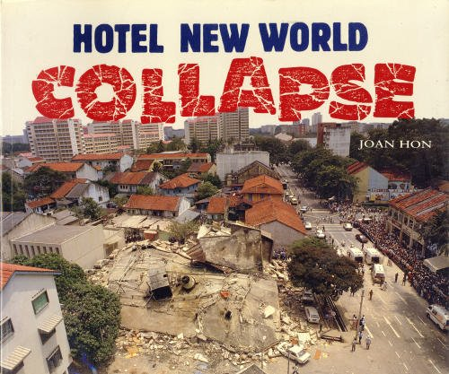
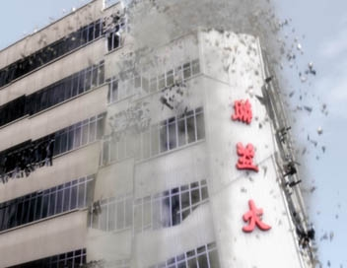
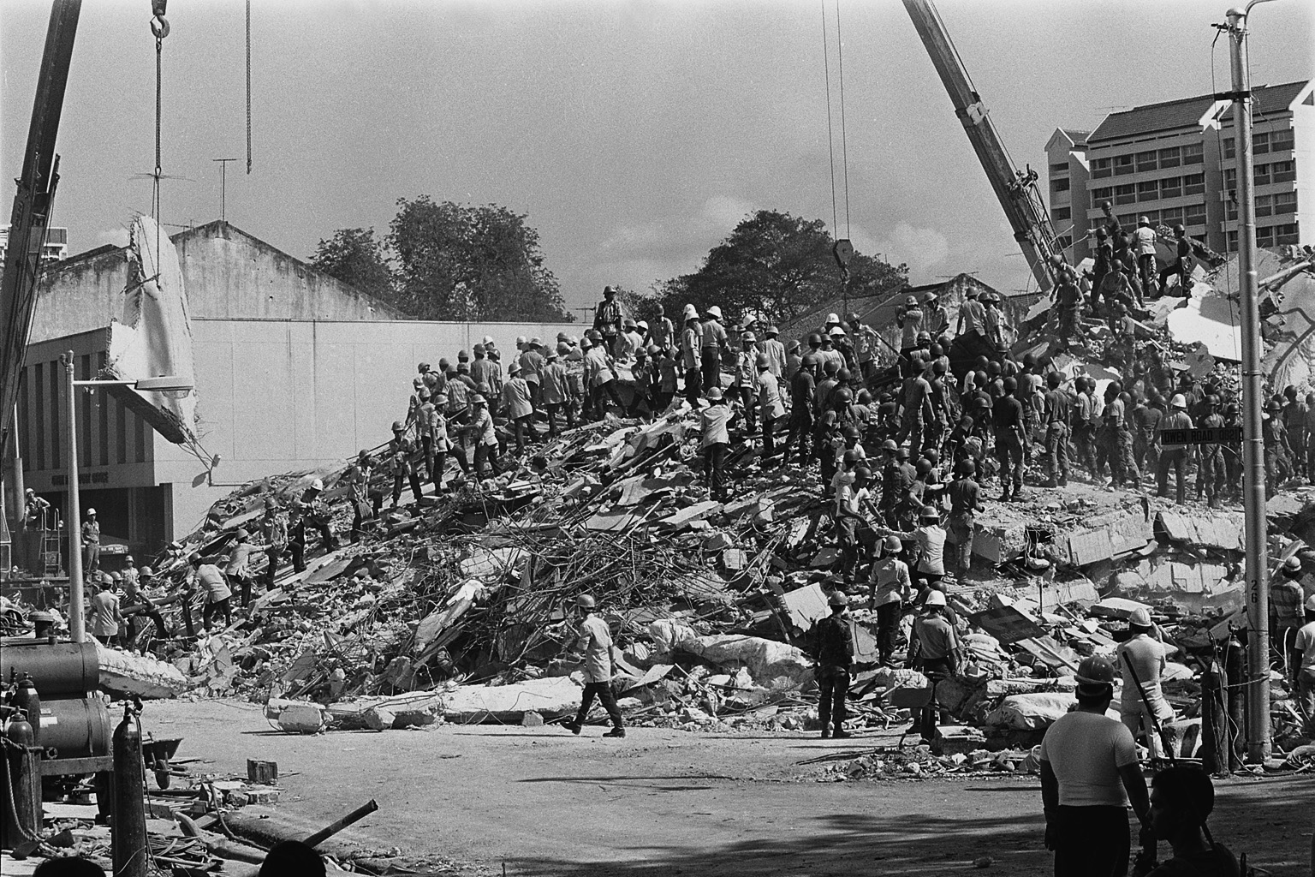
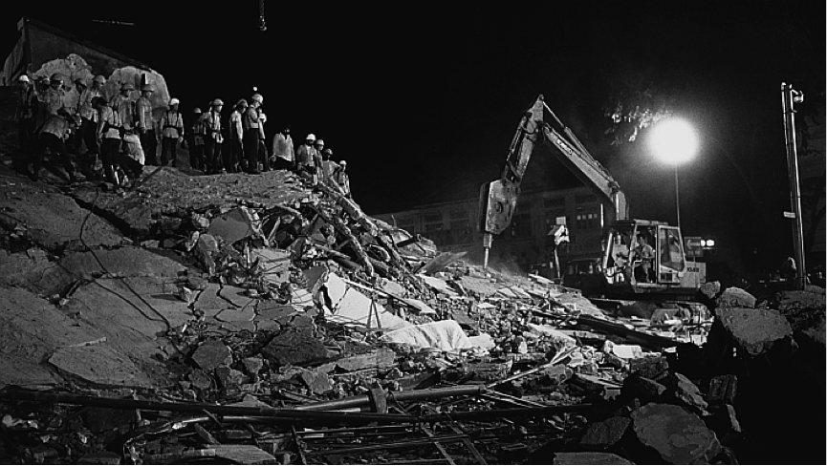

Slide 44
Introduction
4 Statements that should strike fear in us :
We can be seconds from disaster.
Disasters don’t just happen. They had warning signs which were ignored.
Patching up cracks will not prevent the disaster.
Lives lost could have been saved.

Slide 45
15 March 1986.
However, this line of investigation into weight led to the discovery that the original structural engineer had made a serious error in calculating the building's structural load. The structural engineer had calculated the building's live load (the weight of the building's potential inhabitants, furniture, fixtures, and fittings) but the building's dead load (the weight of the building itself) was completely omitted from the calculation. This meant that the building as constructed could not support its own weight. Collapsing was only a matter of time.

Slide 46
Introduction
4 Statements that should strike fear in us :
We can be seconds from disaster.
Disasters don’t just happen. They had warning signs which were ignored.
Patching up cracks will not prevent the disaster.
Lives lost could have been saved.

Slide 49
NT Preaching link at BibleStudyDownloads.org
Get this presentation and script for free!
Notes:
OT Preaching (op)

